Slide 1
Galaxy Morphology Classification Using Convolutional Neural Networks
COMP-4990 Group 36
April 8th, 2022

Slide 2
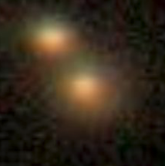
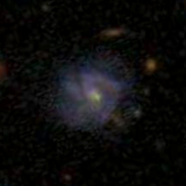
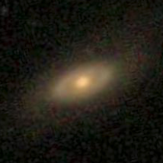
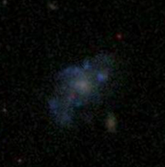
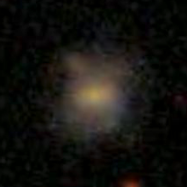
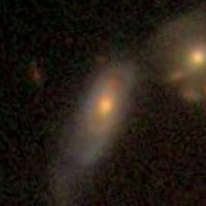
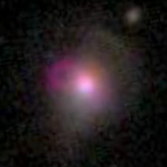
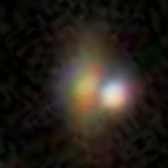
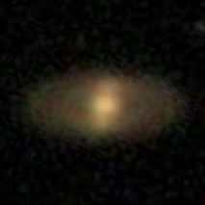
Overview
Visual galaxy morphologies are used by astronomers to study the dynamical structure of the systems for about 90 years. A wide range of morphological features provide information about the history of the host systems.
Our project is aiming for automatically classification of the galaxy images based on their morphological odd features–ring, irregular, merger, and other features.

Slide 3
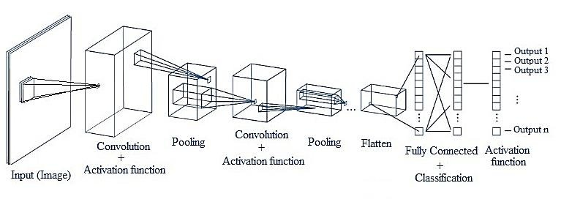
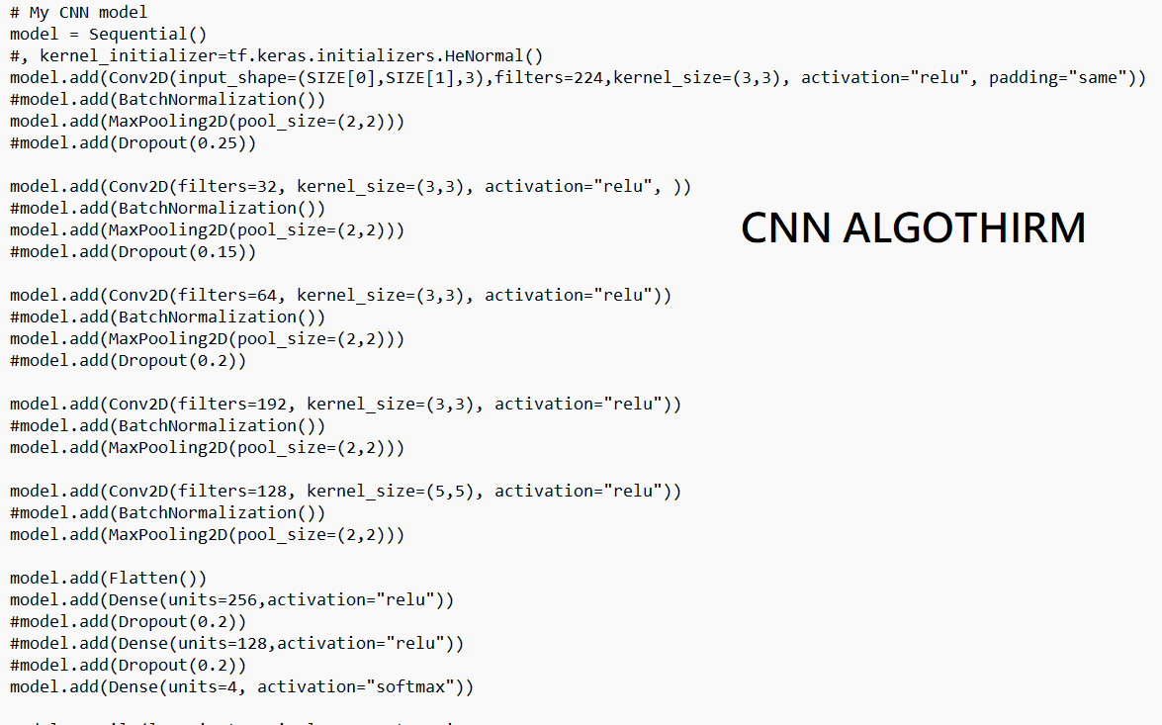
Convolutional Neural Network
We built a Convolutional Neural Network with
5 convolutional layers each followed by a polling layer
Flatten layer
2 dense layers

Slide 4
Technologies
Programing Language
Python
Platform/API/Library
Tensorflow, keras numpy, pandas, sklearn
Google Colab
Connect to and compute on GPU
PyQt5 + Qt Designer
Implement user interface

Slide 5
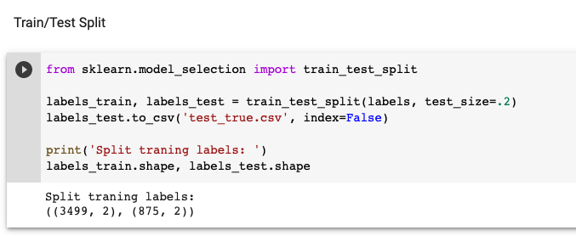
Dataset
4374 images
Training: 3499
Validation: 872

Slide 6
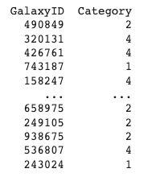
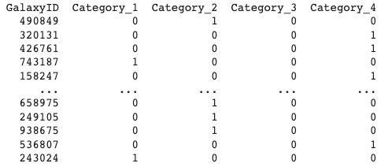
One_hot Encoding
one_hot_train = pd.get_dummies(labels_train, columns = ['Category'])
one_hot_test = pd.get_dummies(labels_test, columns = ['Category'])

Slide 7
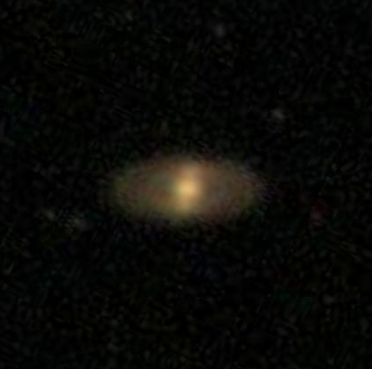
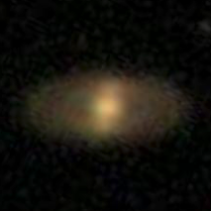
Preprocess the data
Original size: 424*424
After resized: 224*224
img = tf.image.resize_with_crop_or_pad(img, SIZE[0], SIZE[1])

Slide 8
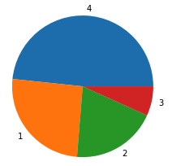
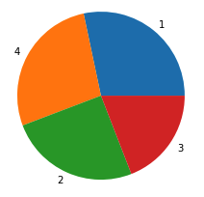
Image data augmentation
Merger
Other
Ring
Irregular
To solve the data imbalance problem, rotate image randomly to generate new images.
def rotate_image(img_path, angle):
img = plt.imread(img_path)
img = imutils.rotate(img, angle)
img = tf.image.resize_with_crop_or_pad(img, SIZE[0], SIZE[1])
img = img/255
return img
def rotate_images(labels):
data = labels.values
img_ids = data[:,0].astype(int).astype(str)
for i in tqdm(img_ids):
angle = 90*random.randint(1, 4)+random.randint(-20, 20)
img = rotate_image('/content/input/training/'+i+'.jpg', angle)
train_imgs.append(img)
images = train_imgs
return images
Ring
Merger
Other
Irregular

Slide 9
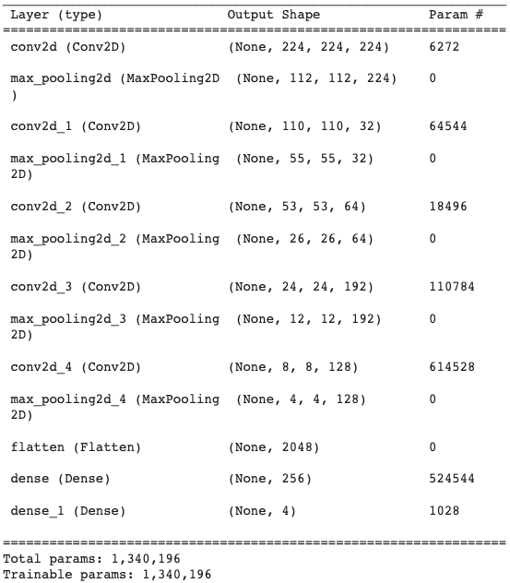
Build CNN Model
KerasTuner is used for hyperparameter search.
Conv2D filters: min_value=32, max_value=256, step=32
Kernel: 3*3 or 5*5
Number of conv layers: 2-5
Number of dense layers: 2-3

Slide 10
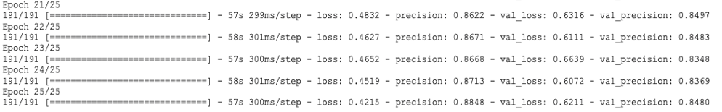
Train the model
Randomly shift, rotate or flip the images during training
Validation precision reaches 84.97%
datagen = ImageDataGenerator(
featurewise_center = False,
samplewise_center = False,
featurewise_std_normalization = False,
samplewise_std_normalization = False,
zca_whitening = False,
rotation_range = 20,
width_shift_range = 0.2,
height_shift_range = 0.2,
horizontal_flip = True,
vertical_flip = False)
datagen.fit(train_imgs)

Slide 11
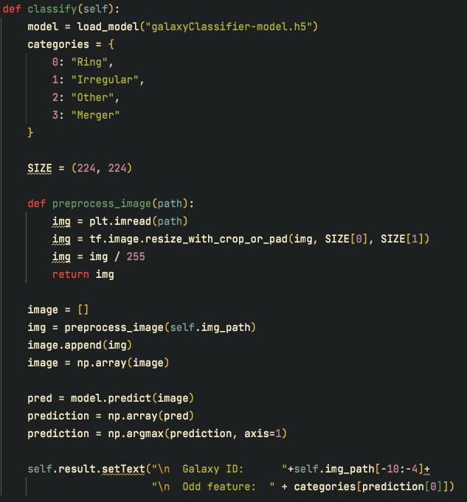
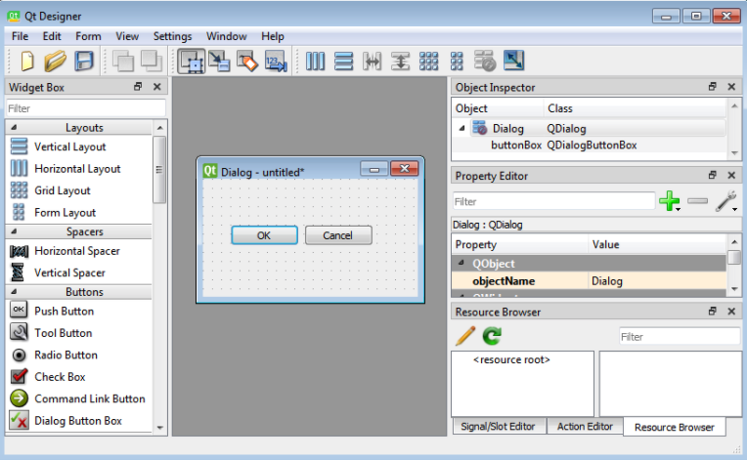
Design User Interface
Qt designer and PyQt5 are used to design the basic user interface

Slide 12
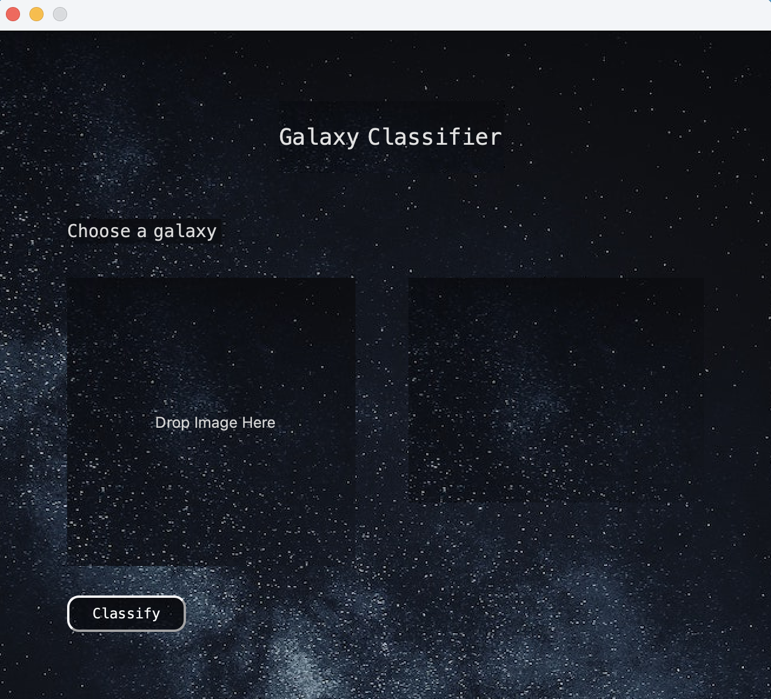
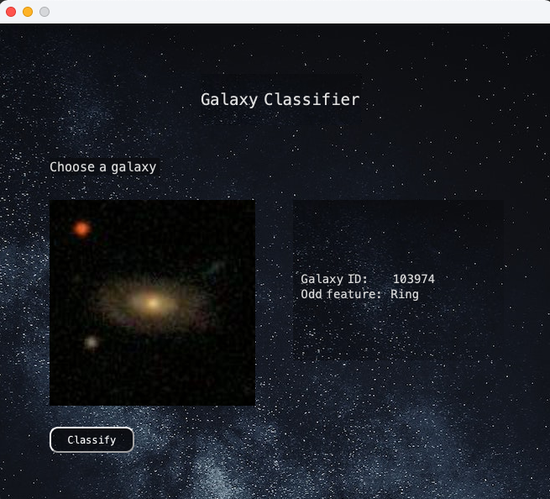
User Interface

Slide 13
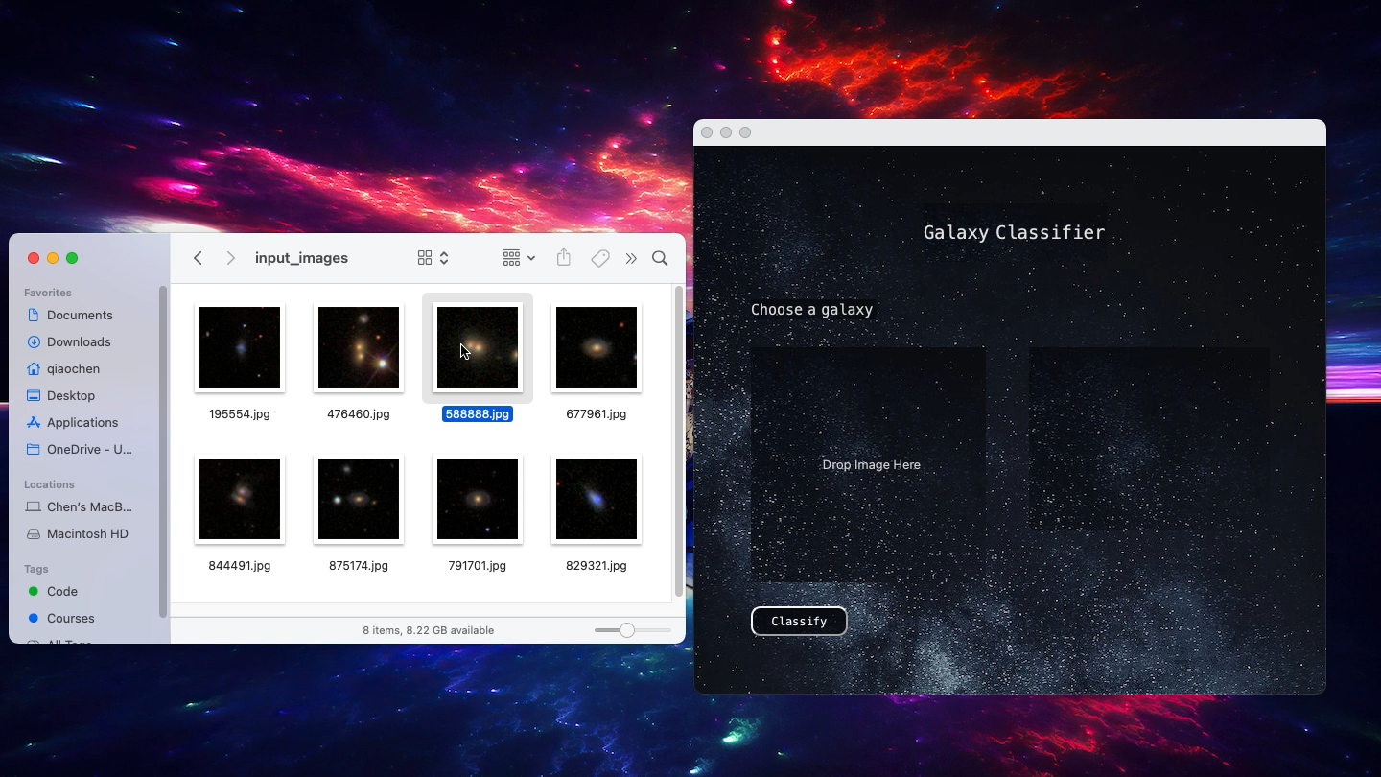

Slide 14
Reference
Melanie R Beck, Claudia Scarlata, Lucy F Fortson, Chris J Lintott, B D Simmons, Melanie A Galloway, Kyle W Willett, Hugh Dickinson, Karen L Masters, Philip J Marshall, Darryl Wright. Integrating human and machine intelligence in galaxy morphology classification tasks. Monthly Notices of the Royal Astronomical Society, Volume 476, Issue 4, June 2018, Pages 5516–5534. https://academic.oup.com/mnras/article/476/4/5516/4923080
M. H UERTAS -C OMPANY, R. G RAVET, G. C ABRERA -V IVES, P.G.P ÉREZ -G ONZÁLEZ, J. S. K ARTALTEPE, G. BARRO, M. B ERNARDI, S. M EI, F. S HANKAR, P. D IMAURO, E.F. B ELL, D. KOCEVSKI, D. C. KOO, S. M. FABER, D. H. M CINTOSH. A catalog of visual-like morphologies in the 5 CANDELS fields using deep-learning. The Astrophysical Journal Supplement Series, Volume 221, Issue 1, article id. 8, 23 pp. (2015)
Jason Brownlee. 8 Tactics to Combat Imbalanced Classes in Your Machine Learning Dataset. Machine Learning Mastery(2015). https://machinelearningmastery.com/tactics-to-combat-imbalanced-classes-in-your-machine-learning-dataset/

Slide 15
Thank you！

